Slide 1
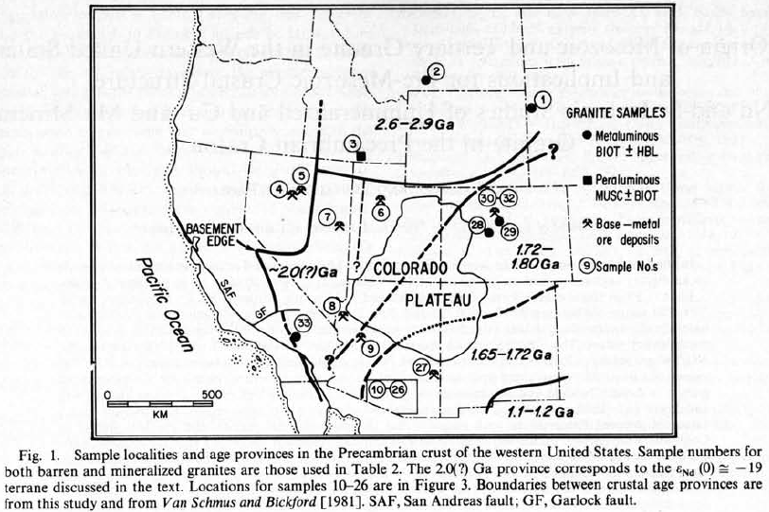
Origin of Mesozoic and tertiary granite in the western united states and implications for pre-Mesozoic crustal structure
Farmer, 1984
Geol 730 Presentation By: Neal Mankins

Slide 2
Purpose
To study the source of silicic magmas formed within a continental craton
Assess the importance of mantle and crustal sources in the generation of granitic rocks
Determine if differences in Precambrain basement affect the spatial distribution of Mesozoic and Cenozoic intrusions
Compare source regions of mineralized and unmineralized intrusive rocks
Method
Nd and Sr isotope compositions from 16 Mesozoic and Tertiary granitic plutons
16 samples associated directly with Cu-Mo mineralization in porphyry deposits

Slide 3
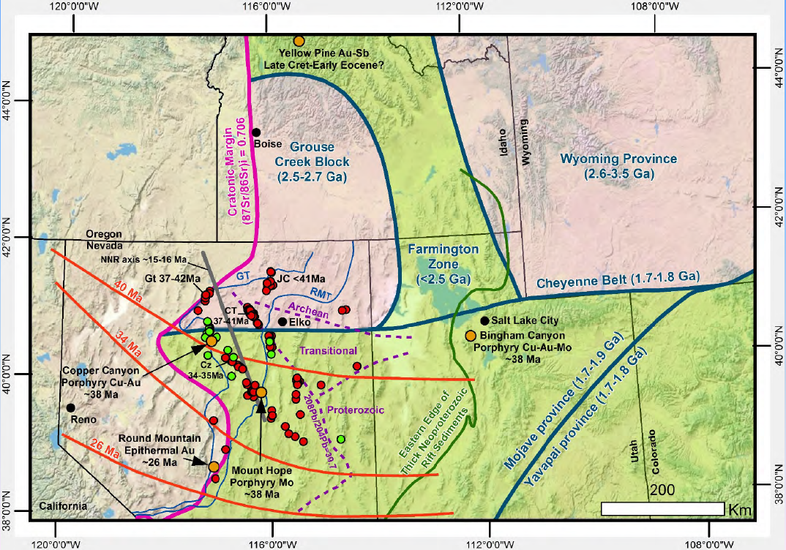
Purpose
(Muntean, 2018)
Method

Slide 4
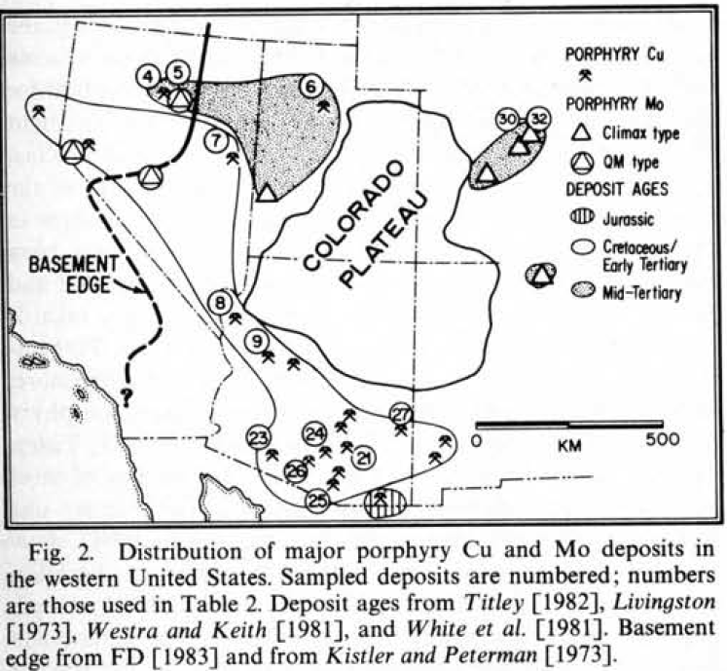
Background
Three Epochs of Magmatism
Jurassic
Arc and back-arc intrusions
Metaluminous calcic to calc-alkaline
Cretaceous
Arc magmatism (Sierra Nevada Batholith)
Metaluminous calcic to calc-alkaline
Tertiary
Eocene volcanism with onset of slab rollback
Calc-alkaline & intermediate-silicic
Note: Nd was found in previous study (DePaolo, 1982) to be immobile during hydrothermal alteration so the initial Nd isotopic composition is preserved

Slide 5
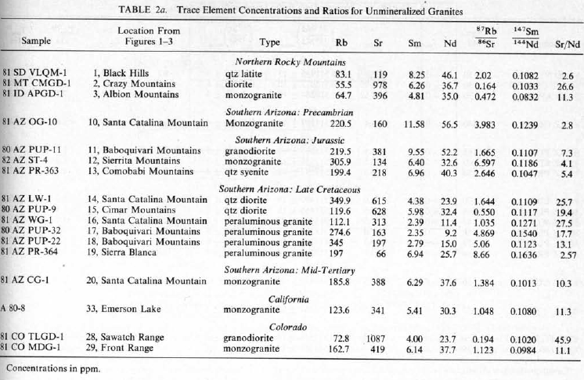
Data
Samples
Hand samples of fresh unaltered plutonic rocks
Drill core of fresh mineralized plutons (unaltered)
Potassic and phyllic altered samples from porphyry copper deposits
(One of MANY tables)
Data
1. Trace element concentrations and ratios for unmineralized granites
2. Trace element concentrations and ratios for mineralized granites
3. Isotope data from unmineralized granites
4. Isotope data from mineralized granites
5. Bulk chemical analysis for ALL samples (determine peraluminous vs metaluminous)

Slide 6
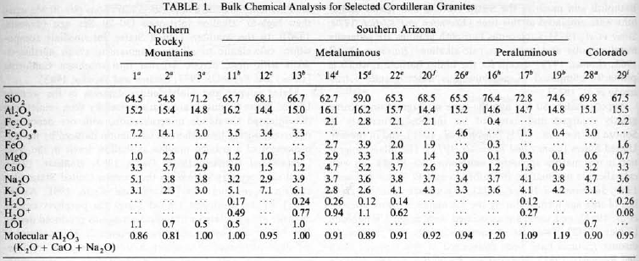
Results 1
Metaluminous Al₂O₃ < (CaO + Na₂O + K₂O)
Higher Nd limits (and wider range) for granites
No correlation between age, bulk composition, or location
Lower Sr limits than peraluminous
Metaluminous granites in the Northern Great Basin have different Sr values than those in Arizona and Colorado
Rare earth element abundances of all metaluminous granites are similar
Peraluminous Al₂O₃ > (CaO + Na₂O + K₂O)
Lower Nd limits for granites
Nd values suggest that peraluminous granites throughout the Western U.S. were derived by melting of typical felsic Precambrian basement
The Sr values do not exhibit consistent regional variations
Rare earth element data on two peraluminous granites have lower values than metaluminous granites

Slide 7
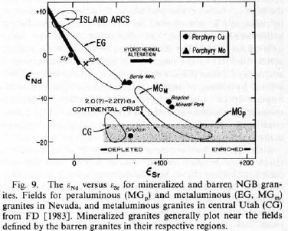
Results 11
Mineralized vs Unmineralized
Nd & Sr ratios indistinguishable from unmineralized granites
No distinction can be made between sources of mineralized and unmineralized granites on the basis of Nd & Sr isotopes

Slide 8
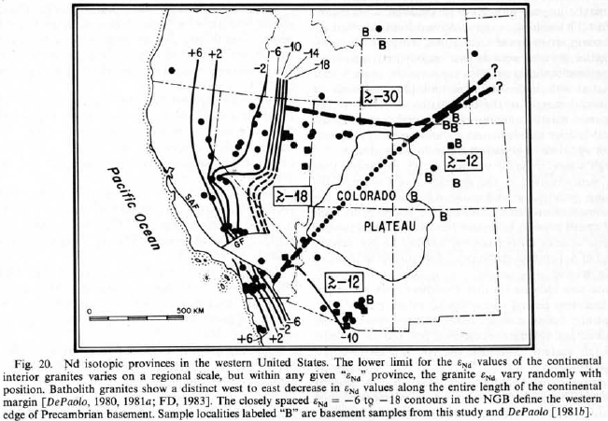
Results 111
Precambrian Basement Age
Nd isotopic compositions of Precambrian crust vary greatly in relation to age and bulk composition while Sr isotopes vary with bulk compositions and metamorphic grade
Precambrian basement of southern Idaho has different Nd isotopic composition from the basement inferred to underlie the Northern Great Basin with the boundary being in northern Utah (Southern limit not constrained well)
Felsic Precambrian basement in southern Arizona is isotopically different from the basement rocks in the Great Basin but similar to the basement in Colorado

Slide 9
Interpretations
Metaluminous granites formed from deep seated mafic magmas with higher Sm/Nd ratios and lower Rb/Sr ratios than average crustal rocks and are interpreted to have formed via mixing of mantle-derived magma and large portions of low ⁸⁷Sr/⁸⁶Sr (granulite facies) lower crust
Granitic rocks that formed near the continental margin were primarily derived from the upper mantle while preexisting continental crust was the dominant source further inland
Peraluminous granites over the whole study area have sources exclusively in felsic Precambrian continental crust

Slide 10
Take Home Points
Nd data confirm that the Precambrian basement underlying the Northern Great Basin is isotopically distinct from Precambrian crust in the remainder of the western U.S.
Nd data indicate that interior granite in the western U.S. was derived from preexisting crust and DO NOT represent significant additions to the crust
There are no significant differences between sources in mineralized vs unmineralized granites thus magma source does not control whether an ore deposit will form
Precambrian basement does affect the spatial distribution of Mesozoic and Cenozoic intrusions

